Slide 1


K.RAMAKRISHNAN COLLEGE OF TECHNOLOGY
(AUTONOMOUS), TRICHY.
DEPARTMENT OF
COMPUTER SCIENCE AND ENGINEERING
20CS5501 DESIGN PROJECT-1
Batch No. : 04
Date : 05.12.2024

Slide 2
BLOOD DONOR NOTIFICATION SYSTEM
Guided by Team
Mrs. A. Thenmozhi M.E Abinesh R (811722104005)
Assistant Professor, CSE Anbazhagan P (811722104011)
Haribharathi R (811722104047)

Slide 3
OBJECTIVE OF THE PROJECT
Efficient Blood Matching: Automate matching between blood donors and recipients based on blood group.
Real-Time Notifications: Send instant SMS alerts to matching donors when a blood request is made.
Data Management: Maintain a database of donors with their details for quick searches.
Accessibility: Provide a platform for hospitals or individuals to request blood efficiently.
Emergency Response: Enhance response time during critical blood shortages.

Slide 4
ABSTRACT
The Blood Donor Notification System is a web-based platform designed to facilitate efficient and timely blood donation processes by connecting blood donors with recipients. The system maintains a comprehensive database of registered donors, including their contact details, blood group, and availability. When a blood request is initiated, the system identifies donors with the matching blood group and automatically sends SMS notifications to inform them about the urgent requirement. This project aims to streamline the blood donation process, reduce delays in finding donors, and enhance the availability of blood during emergencies. By leveraging technology, the system ensures an effective response to critical healthcare needs.

Slide 5
LITERATURE SURVEY
TITLE OF THE PAPER | AUTHOR (S) | PUBLISHER | PAPER GIST | TECHNOLOGY USED
TITLE OF THE PAPER | AUTHOR(S) | PUBLISHER | PAPER GIST | TECHNOLOGY USED
Blood Bank Management System | S. Kumar, R. Singh | IEEE | Details a manual and computerized system to track blood inventory and donors. | SQL, VB.NET
Traditional Blood Donation Record System | M. Johnson | Elsevier | Focuses on maintaining manual donor records with partial digitization. | MS Access, Basic SQL
Blood Stock Monitoring System | K. Sharma | Springer | Introduces a basic database system for managing blood stock in small banks. | PHP, MySQL
Centralized Blood Donation Registry | T. Wilson, A. Brown | Taylor & Francis | Discusses a database-driven registry for donor and request matching. | HTML, CSS, MySQL
Basic Blood Inventory Management | P. Gupta | ACM | Explains a simple framework for inventory tracking without automation. | Excel, MS Access

Slide 6
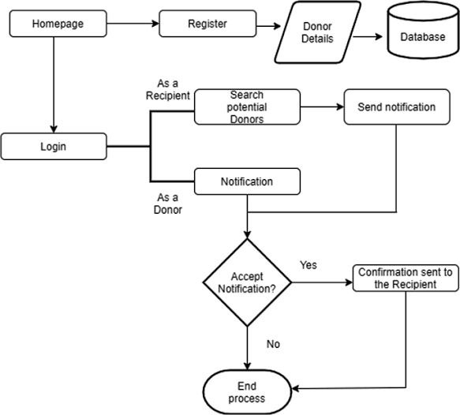
PROPOSED SYSTEM ARCHITECTURE

Slide 7
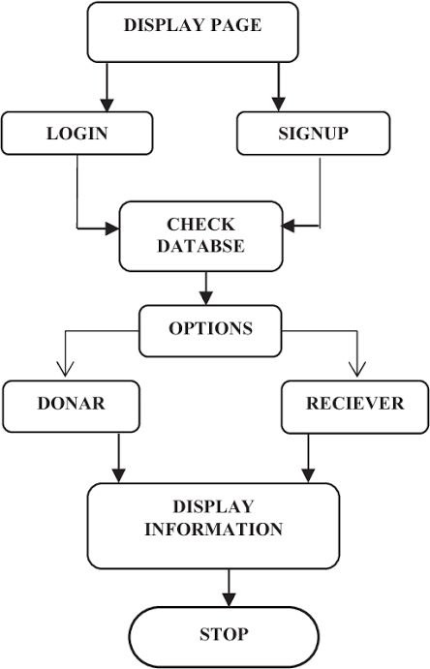
EXISTING SYSTEM ARCHITECTURE

Slide 8
SOFTWARE AND HARDWARE REQUIREMENTS
HARDWARE
SOFTWARE
Front end
html
Css
java script
Backend
MySQL
php
xampp
Desktop/Laptop:
Processor: Dual-core CPU (e.g., Intel Core i3)
RAM:6 GB
Storage: 50 GB free disk space
Display: 1280x800 resolution
Mobile Devices:
RAM: 8 GB
OS: Latest iOS or Android
Display: 720p resolution

Slide 9
MODULES
User Registration Module: Collects and stores donor details, including name, contact number, blood group, and optional location.
Login and Authentication Module: Allows secure access for users and admins to the system.
Blood Search Module: Facilitates searching for donors based on the requested blood group.
Notification Module: Sends automated SMS alerts to matching donors during a blood request.
Admin Dashboard Module: Enables management of donor records and monitoring of blood requests.

Slide 10
SUMMARY OF MODULE-1
UserRegistration Module:
This module allows individuals to register as blood donors by providing essential details such as their full name, contact number, blood group, location (optional), and the date of their last donation. These details are stored securely in the system’s database. The module ensures that only eligible and valid information is captured to maintain the integrity of the donor database.

Slide 11
SUMMARY OF MODULE-2
Login and Authentication Module
This module is responsible for authenticating users and administrators who access the system. Each user is assigned credentials (username and password) during registration. The module ensures secure login by encrypting passwords and verifying user authenticity. Administrators have additional privileges for managing the system’s data and operations.

Slide 12
SUMMARY OF MODULE-3
Blood Search Module
The blood search module is the heart of the system. It allows users to search for donors by specifying the required blood group. The system scans the donor database for matches and displays a list of potential donors who can be contacted or notified. It also includes filters such as location or last donation date to refine the search results.

Slide 13
SUMMARY OF MODULE-4
Notification Module
The notification module automates communication with donors. Once a search is completed, and matching donors are identified, this module sends SMS alerts to them. The message includes details of the request, such as the required blood group, the requester’s contact information, and any relevant location or urgency details. This ensures a prompt response from donors during emergencies.

Slide 14
SUMMARY OF MODULE-5
Admin Dashboard Module
This module provides an interface for system administrators to manage the donor database and monitor system activity. Administrators can add, update, or delete donor records, track blood requests, and generate reports for analysis. This module ensures the smooth functioning of the system and provides insights into donation trends and response times.

Slide 15
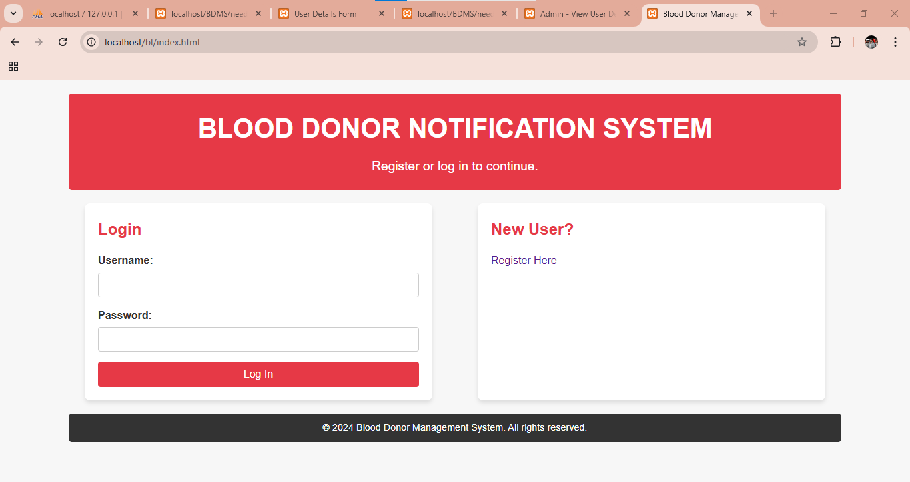
RESULTS AND DISCUSSION

Slide 16
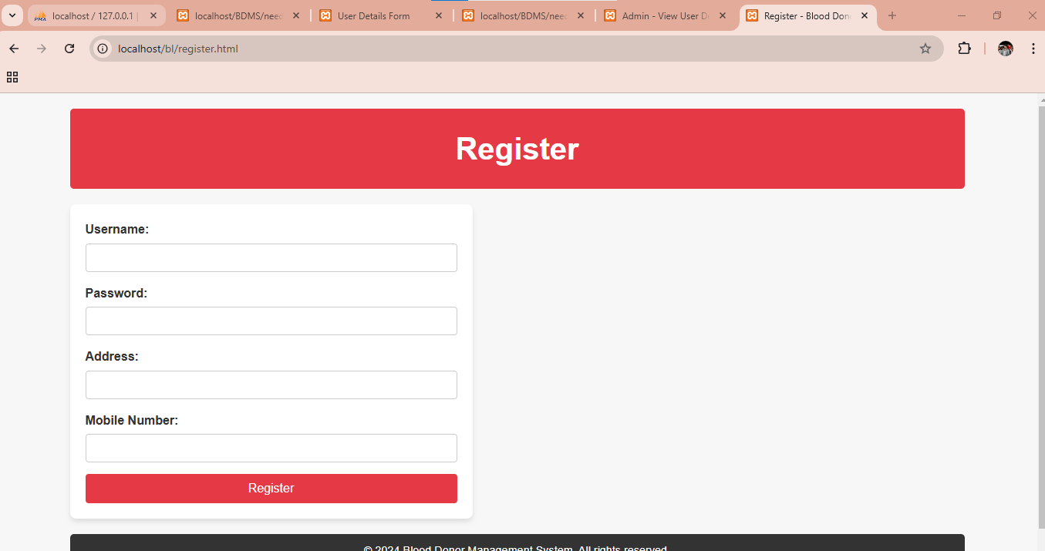
RESULTS AND DISCUSSION

Slide 17
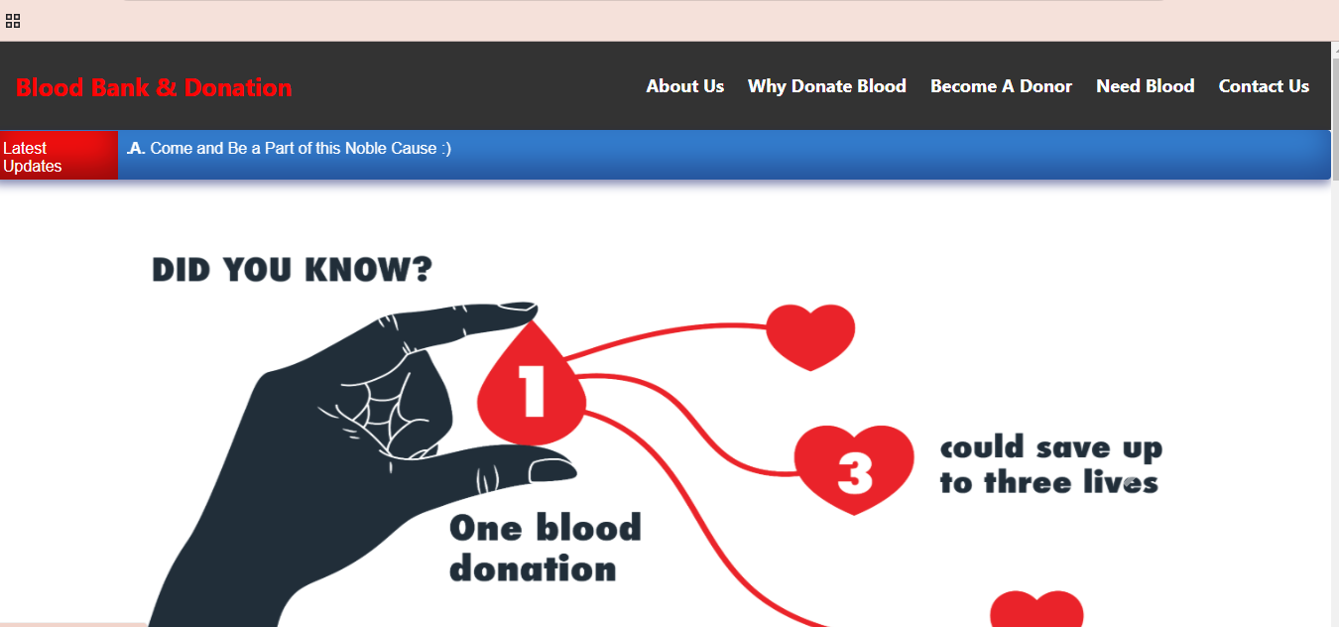
RESULTS AND DISCUSSION

Slide 18
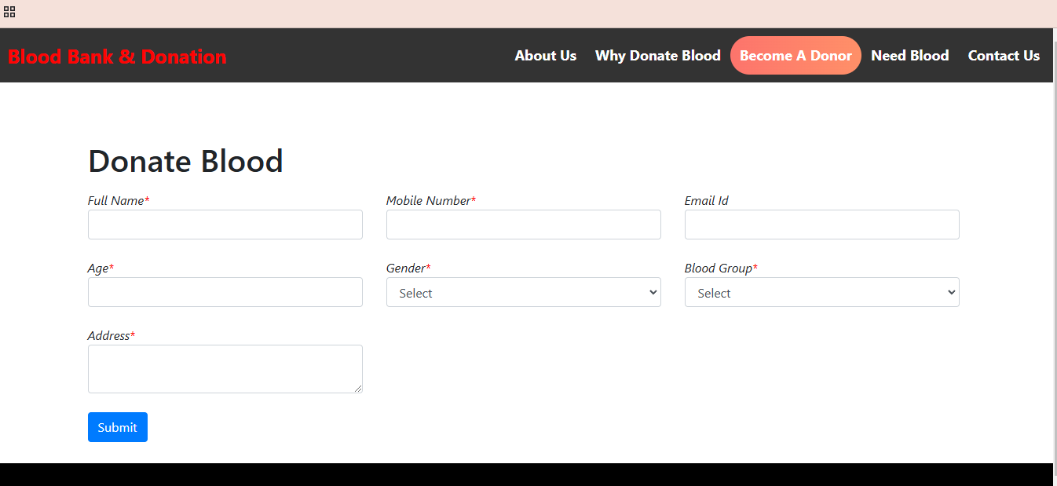
RESULTS AND DISCUSSION

Slide 19
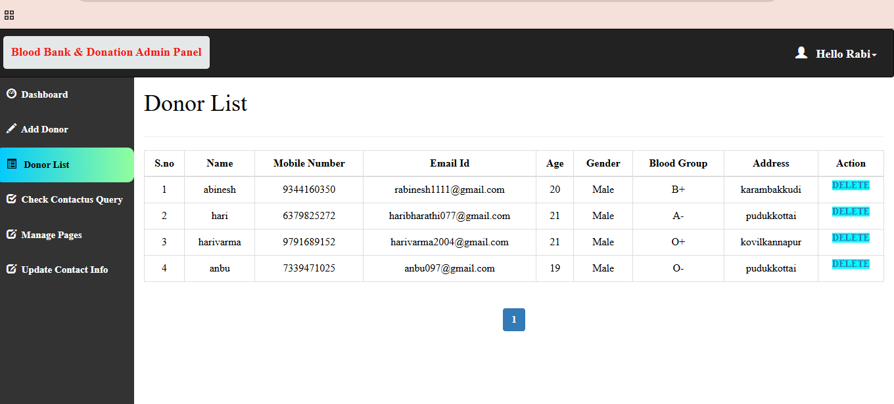
RESULTS AND DISCUSSION

Slide 20
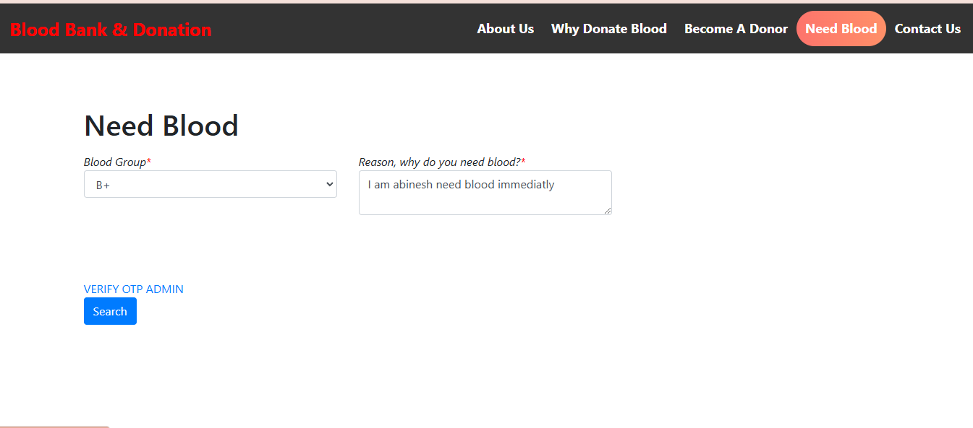
RESULTS AND DISCUSSION

Slide 21
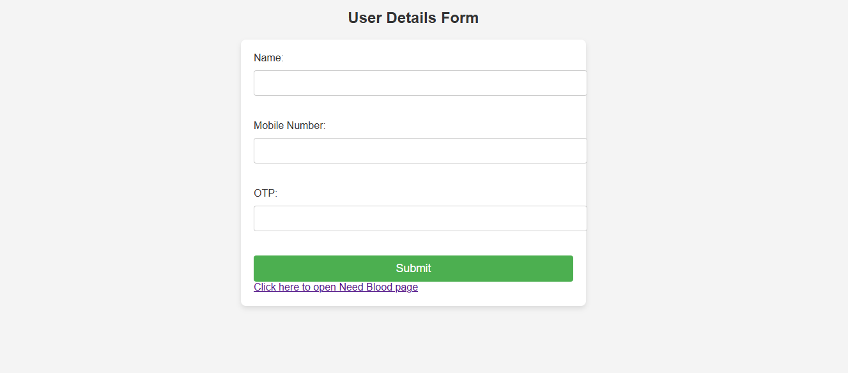
RESULTS AND DISCUSSION

Slide 22
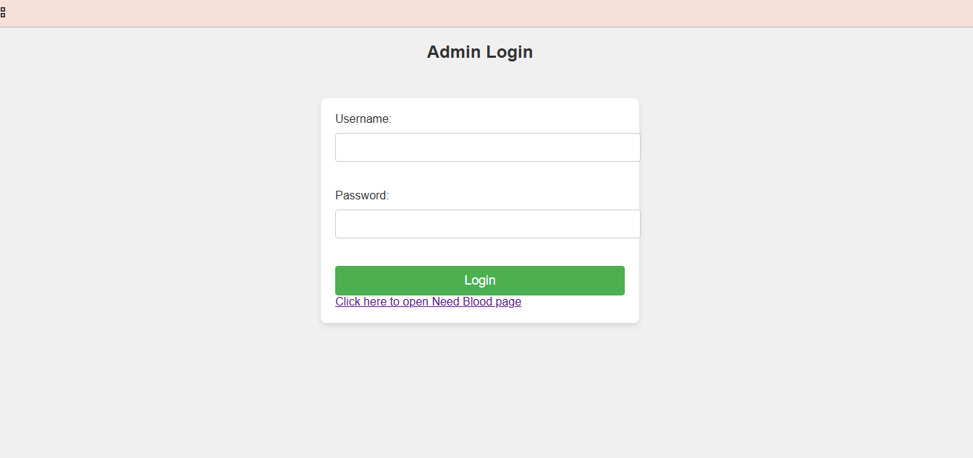
RESULTS AND DISCUSSION

Slide 23
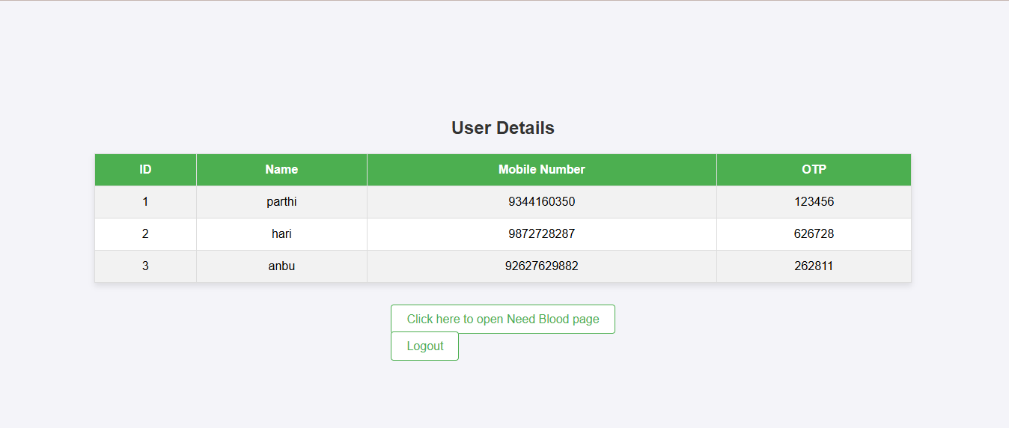
RESULTS AND DISCUSSION

Slide 24
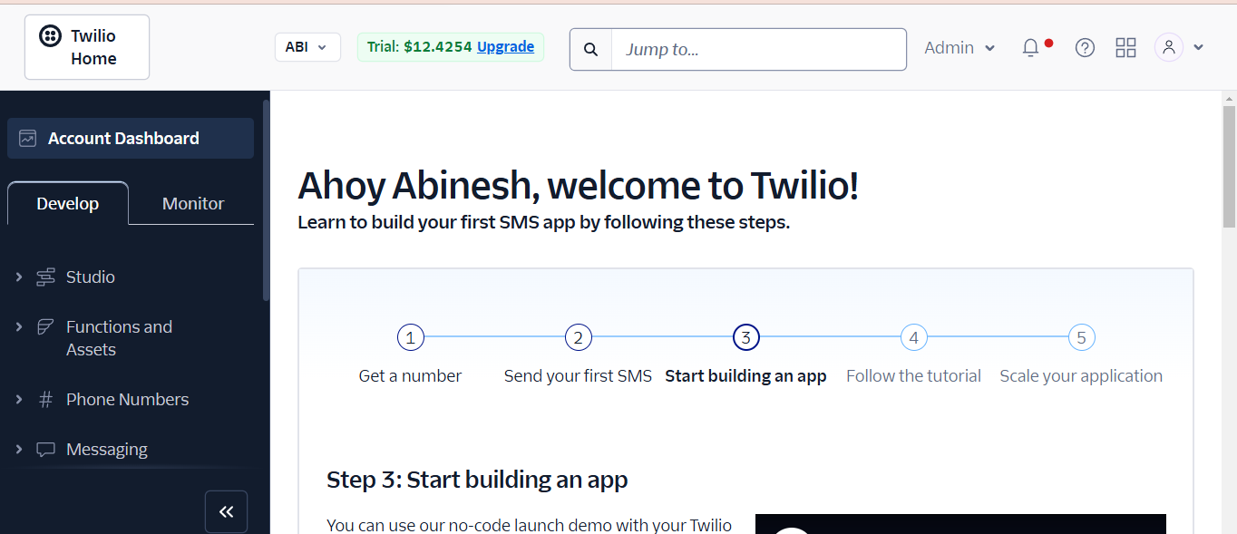
RESULTS AND DISCUSSION

Slide 25
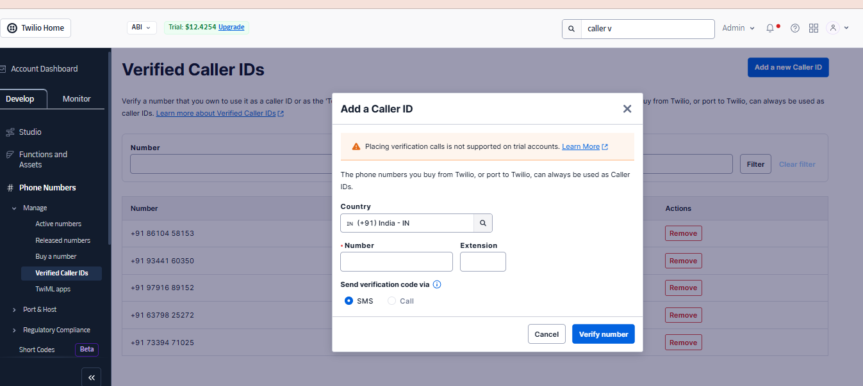
RESULTS AND DISCUSSION

Slide 26
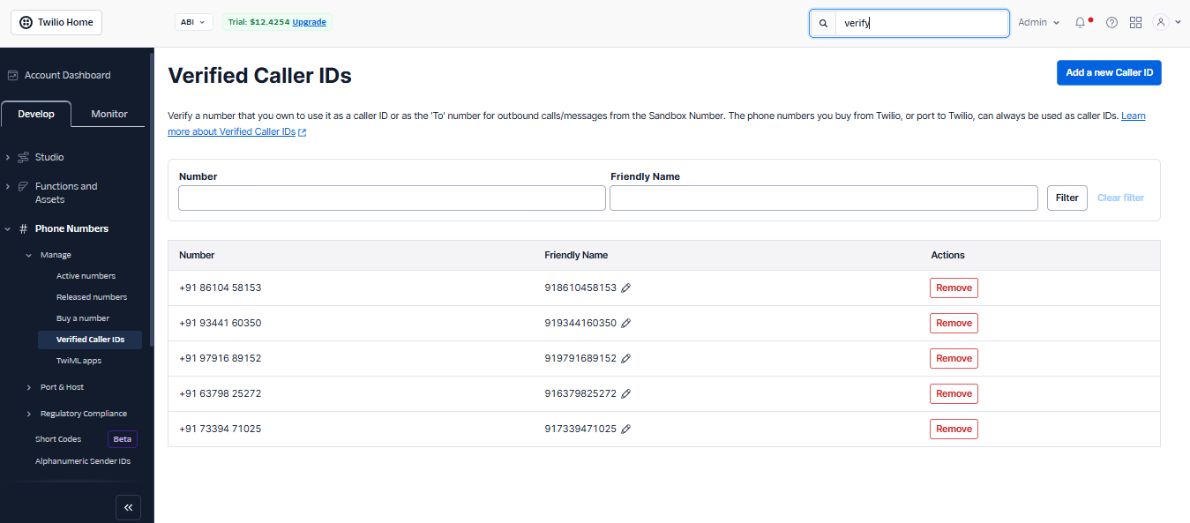
RESULTS AND DISCUSSION

Slide 27

RESULTS AND DISCUSSION

Slide 28
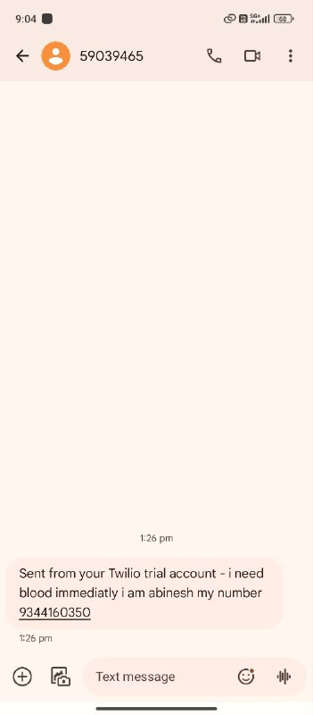
RESULTS AND DISCUSSION

Slide 29
CONCLUSION
Life-Saving System: Facilitates timely blood donation by connecting donors and recipients efficiently.
Automated Notifications: Sends SMS alerts to matching donors, ensuring prompt responses in emergencies.
Comprehensive Database: Maintains accurate and secure donor records for quick searches.
User-Friendly Platform: Simplifies the process of finding and contacting blood donors.
Scalable Solution: Can be enhanced with features like location-based filters and real-time tracking for broader impact.

Slide 30
THANK YOU

